Slide 1

Developer management in Software House
Presenter: Taha Ali 21K-3867 Imran Ali 21K-3877 Taha Jawaid 21K-3881

Slide 2

Introduction
Today, we delve into a comparative analysis of two distinct IT organizations, Dreamzplanet and Fixkar solutions, to explore the modern practices and employee experiences shaping the dynamic world of Information Technology.

Slide 3
Problem statement
The project aims to study and document professional practices in a specific IT domain by conducting a case study of a chosen organization. The focus is to explore and analyze the organization's operations, identify best practices, and understand challenges within the domain. The study involves gathering data through interviews and questionnaires, presenting findings, and suggesting improvements to enhance organizational efficiency and compliance.

Slide 4
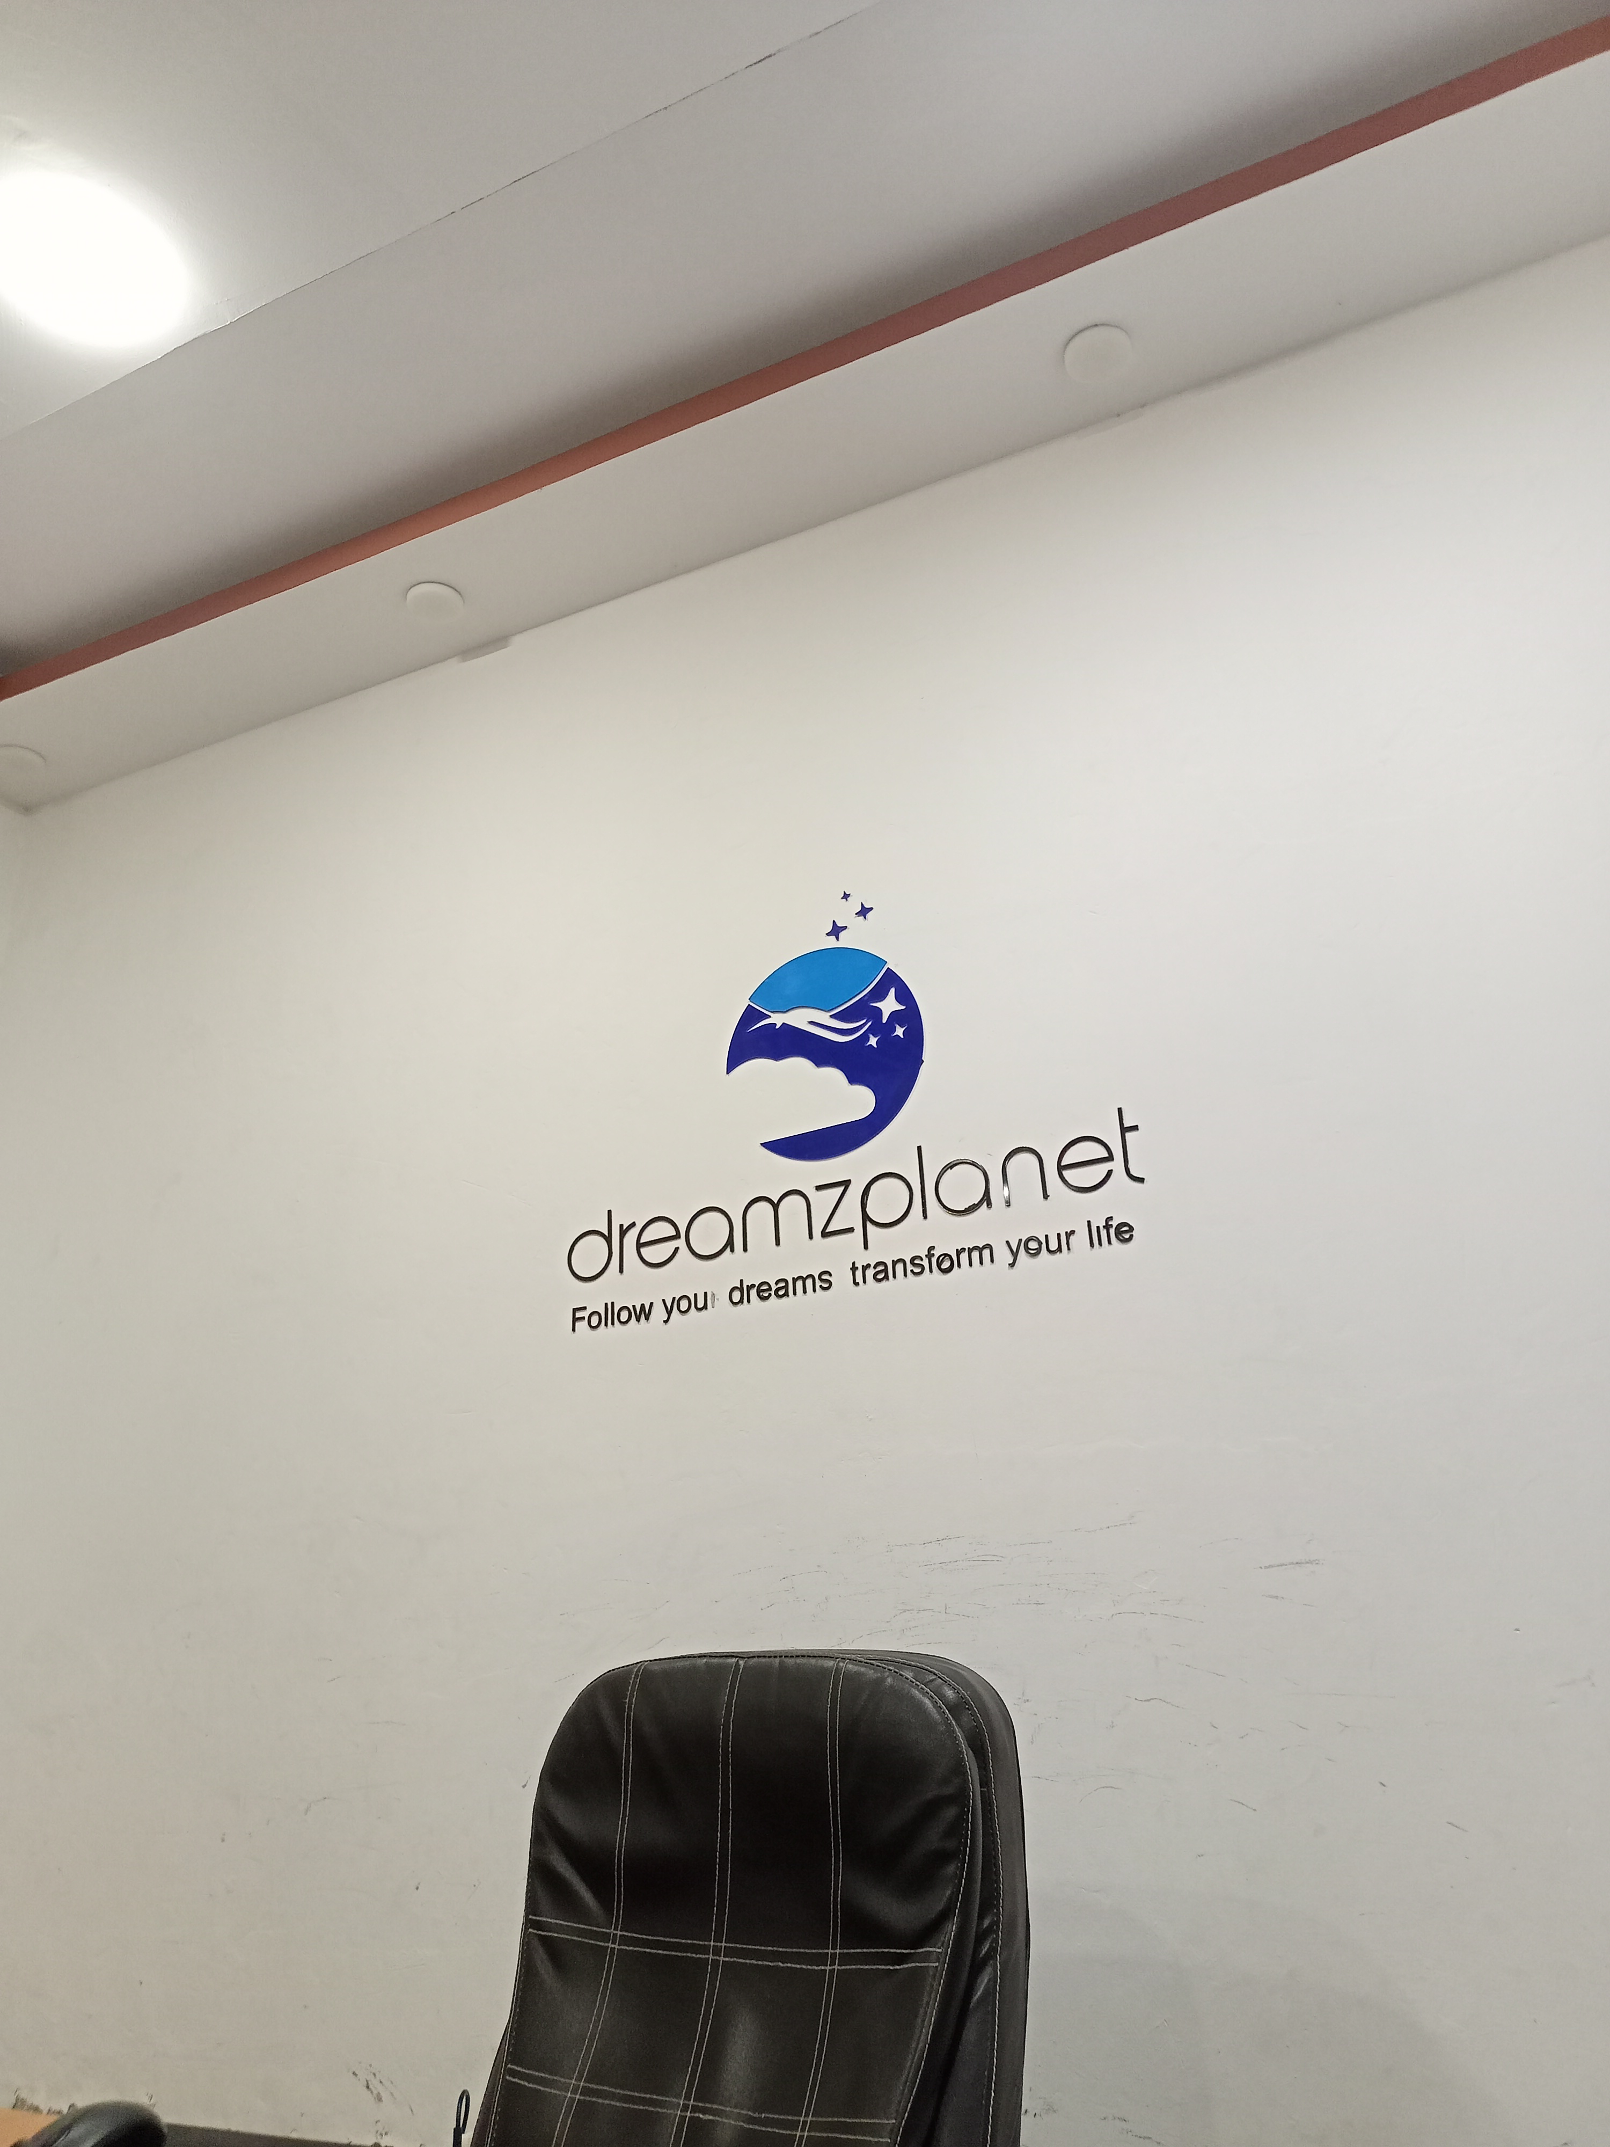
Introduction of Interviewed Organizations
Dreamzplanet: A product-based company in Karachi, Pakistan, with 100+ employees globally, offices in multiple countries, and a focus on modern IT practices.
Fixkar Solutions:
A service-based company in Karachi with 100+ employees, project-based work, and reliance on legacy systems.

Slide 5

Form of interview:
In-person interviews conducted with software developers at both organizations.
Questionnaires designed for anonymous responses to gauge genuine employee sentiments

Slide 6
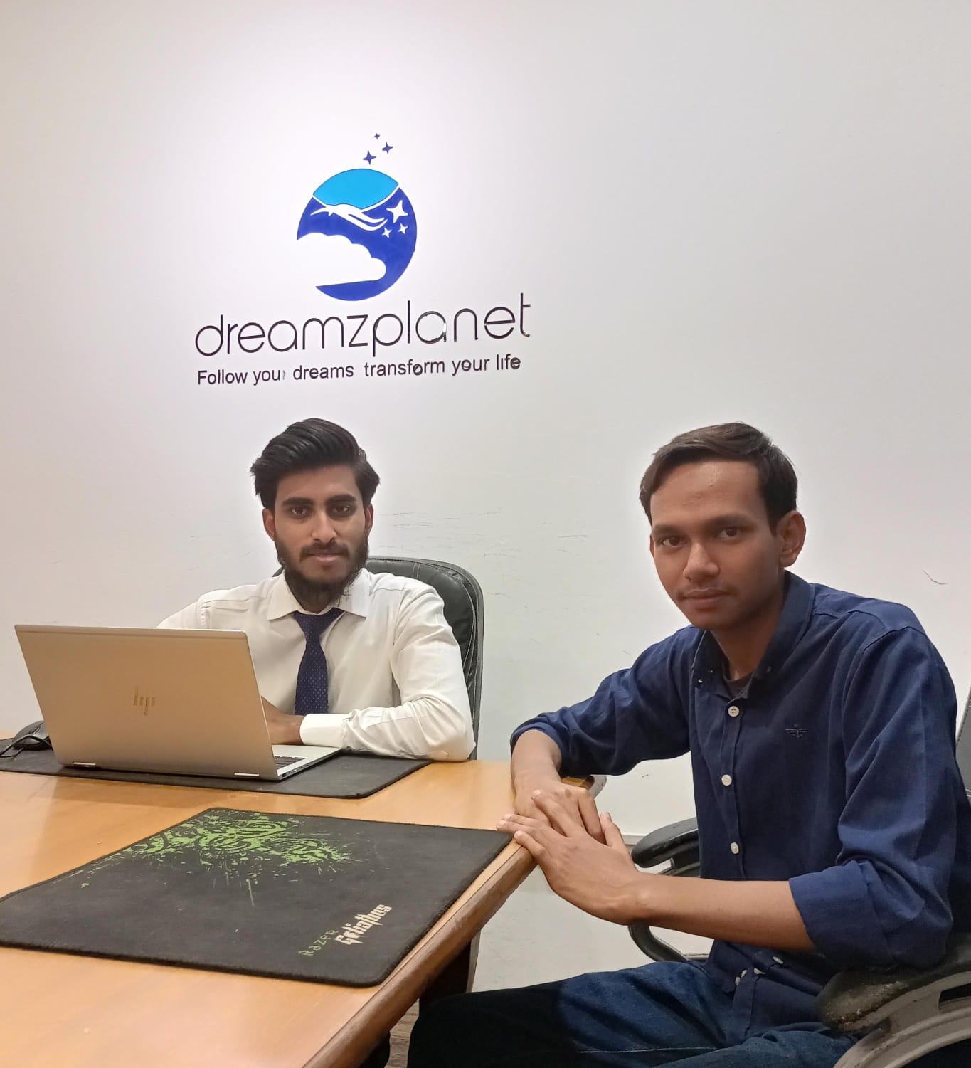
Questionnaire and Responses: dreamzplanet
Positive emphasis on modern development processes.
Collaboration through tools like Slack, agile methodologies, and code reviews.
Strong focus on employee well-being, work-life balance, and continuous training.
Clear vision for future technologies, high morale among employees.

Slide 7
FIXKAR SOlutions:
Reliance on legacy systems, bureaucratic processes, and waterfall development.
Limited training opportunities and slow feedback implementation.
Unpredictable work-life balance, lack of knowledge about future directions.

Slide 8
Comparative Analysis:
Development Processes:
Dreamzplanet: Agile and iterative, collaborative, emphasis on code reviews.
Fixkar Solutions: Waterfall, bureaucratic, manager-centric code reviews.
Training and Development:
Dreamzplanet: Continuous training, sponsorships for certifications.
Fixkar Solutions: Limited development programs, employees self-learn.
Work-Life Balance:
Dreamzplanet: Hybrid model, flexible work arrangements, focus on well-being.
Fixkar Solutions: Unpredictable, no paid leaves, surge in deliverables.

Slide 9
Comparative Analysis:
Standards and Procedures:
Dreamzplanet: Implementation of standards like GDPR.
Fixkar Solutions : Employees have room for making decisions themselves.
Employee Sentiments:
Dreamzplanet : Ownership, Sense of Responsibility, employee recreational facilities
Fixkar Solutions: Employee anxiety, self-management, all-around the job experience.
Management Satisfaction:
Dreamzplanet: Strong sense of company values and family, collaboration and cooperation.
Fixkar Solutions: Sense of disparity, lack of transparency.

Slide 10

Conclusion on Comparative Analysis:
Dreamzplanet demonstrates modern practices, employee-centric approaches. Collaboration and ownership, limited learning.
Fixkar solutions relies on traditional methods, lacks innovation, good working environment.
Dreamzplanet fosters a positive and collaborative culture, while Fixkar solutions faces challenges in employee engagement.

Slide 11


Feedback and Final Take:
dreamzplanet serves as a benchmark for modern IT practices.
Recommendations for Fixkar solution include adopting newer technologies, streamlining processes, and focusing on employee well-being.
Comparative analysis highlights the importance of adapting to modern IT trends for organizational success.

Slide 12



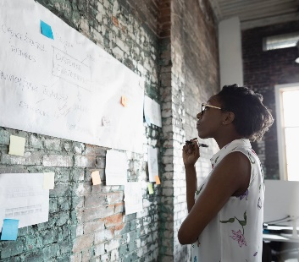
Thank you

